Slide 1

Quick-Sort
Dr. Aiman Hanna
Department of Computer Science & Software Engineering
Concordia University, Montreal, Canada
These slides has been extracted, modified and updated from original slides of :
Data Structures and Algorithms in Java, 5th edition. John Wiley& Sons, 2010. ISBN 978-0-470-38326-1.
Data Structures and the Java Collections Framework by William J. Collins, 3rdedition, ISBN 978-0-470-48267-4. Both books are published by Wiley.
Copyright © 2010-2011 Wiley
Copyright © 2010 Michael T. Goodrich, Roberto Tamassia
Copyright © 2011 William J. Collins
Copyright © 2011-2012 Aiman Hanna
All rights reserved
Merge Sort

Slide 2
Coverage
Section 11.2: Quick-Sort
7 4 9 6 2 → 2 4 6 7 9
4 2 → 2 4
7 9 → 7 9
2 → 2
9 → 9
Merge Sort

Slide 3
Quick-Sort
Quick-sort is a randomized sorting algorithm based on the divide-and-conquer paradigm:
  Divide: pick a random element x (called pivot) and partition S into
    L elements less than x
    E elements equal x
    G elements greater than x
  Recur: sort L and G
  Conquer: join L, E and G
x
x
L
G
E
x
Quick-Sort

Slide 4
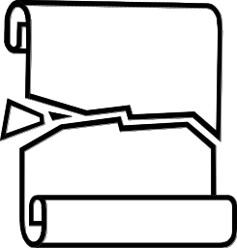
Partition
We partition an input sequence as follows:
  We remove, in turn, each element y from S and
  We insert y into L, E or G, depending on the result of the comparison with the pivot x
Each insertion and removal is at the beginning or at the end of a sequence, and hence takes O(1) time
Thus, the partition step of quick-sort takes O(n) time
Algorithm partition(S, p)
Input sequence S, position p of pivot
Output subsequences L, E, G of the
elements of S less than, equal to,
or greater than the pivot, resp.
L, E, G ← empty sequences
  x ← S.remove(p)
  while ¬S.isEmpty()
  y ← S.remove(S.first())
  if y < x
  L.addLast(y)
  else if y = x
  E.addLast(y)
  else { y > x }
  G.addLast(y)
  return L, E, G
Quick-Sort

Slide 5
Quick-Sort Tree
An execution of quick-sort is depicted by a binary tree
  Each node represents a recursive call of quick-sort and stores
    Unsorted sequence before the execution and its pivot
    Sorted sequence at the end of the execution
  The root is the initial call
  The leaves are calls on subsequences of size 0 or 1

Slide 6
Quick-Sort Tree
Example:
85 24 63 45 17 31 96 50
24 45 17 31
85 63 96
Divide & Recur
24 17
45
85 63
24
85
Quick-Sort

Slide 7
Quick-Sort Tree
Example (Continues…):
17 24 31 45 50 63 85 96
17 24 31 45
63 85 96
Conquer
17 24
45
63 85
24
85
Quick-Sort

Slide 8
Execution Example
Pivot selection
7 2 9 4 3 7 6 1 → 1 2 3 4 6 7 8 9
7 2 9 4 → 2 4 7 9
3 8 6 1 → 1 3 8 6
2 → 2
9 4 → 4 9
3 → 3
8 → 8
9 → 9
4 → 4
Quick-Sort

Slide 9
Execution Example (cont.)
Partition, recursive call, pivot selection
7 2 9 4 3 7 6 1 → 1 2 3 4 6 7 8 9
2 4 3 1 → 2 4 7 9
3 8 6 1 → 1 3 8 6
2 → 2
9 4 → 4 9
3 → 3
8 → 8
9 → 9
4 → 4
Quick-Sort

Slide 10
Execution Example (cont.)
Partition, recursive call, base case
7 2 9 4 3 7 6 1 → → 1 2 3 4 6 7 8 9
2 4 3 1 →→ 2 4 7
3 8 6 1 → 1 3 8 6
1 → 1
9 4 → 4 9
3 → 3
8 → 8
9 → 9
4 → 4
Quick-Sort

Slide 11
Execution Example (cont.)
Recursive call, …, base case, join
7 2 9 4 3 7 6 1 → 1 2 3 4 6 7 8 9
2 4 3 1 → 1 2 3 4
3 8 6 1 → 1 3 8 6
1 → 1
4 3 → 3 4
3 → 3
8 → 8
9 → 9
4 → 4
Quick-Sort

Slide 12
Execution Example (cont.)
Recursive call, pivot selection
7 2 9 4 3 7 6 1 → 1 2 3 4 6 7 8 9
2 4 3 1 → 1 2 3 4
7 9 7 1 → 1 3 8 6
1 → 1
4 3 → 3 4
8 → 8
9 → 9
9 → 9
4 → 4
Quick-Sort

Slide 13
Execution Example (cont.)
Partition, …, recursive call, base case
7 2 9 4 3 7 6 1 → 1 2 3 4 6 7 8 9
2 4 3 1 → 1 2 3 4
7 9 7 1 → 1 3 8 6
1 → 1
4 3 → 3 4
8 → 8
9 → 9
9 → 9
4 → 4
Quick-Sort

Slide 14
Execution Example (cont.)
Join, join
7 2 9 4 3 7 6 1 → 1 2 3 4 6 7 7 9
2 4 3 1 → 1 2 3 4
7 9 7 → 17 7 9
1 → 1
4 3 → 3 4
8 → 8
9 → 9
9 → 9
4 → 4
Quick-Sort

Slide 15
Worst-case Running Time
The worst case for quick-sort occurs when the pivot is the unique minimum or maximum element
One of L and G has size n − 1 and the other has size 0
The amount or work done at any depth proportional to the number of nodes at that depth. Hence, the running time in that case is proportional to the sum
n + (n − 1) + … + 2 + 1
Thus, the worst-case running time of quick-sort is O(n²)
depth | time
0 | n
1 | n − 1
… | …
n − 1 | 1
…
Quick-Sort

Slide 16
Expected Running Time
Consider a recursive call of quick-sort on a sequence of size s
  Good call: the sizes of L and G are each less than 3s/4
  Bad call: one of L and G has size greater than 3s/4
A call is good with probability 1/2
  1/2 of the possible pivots cause good calls:
7 2 9 4 3 7 6 1 9
7 2 9 4 3 7 6 1
2 4 3 1
7 9 7 1 → 1
1
7 2 9 4 3 7 6
Good call
Bad call
1 2 3 4 5 6 7 8 9 10 11 12 13 14 15 16
Bad pivots
Good pivots
Bad pivots
Quick-Sort

Slide 17
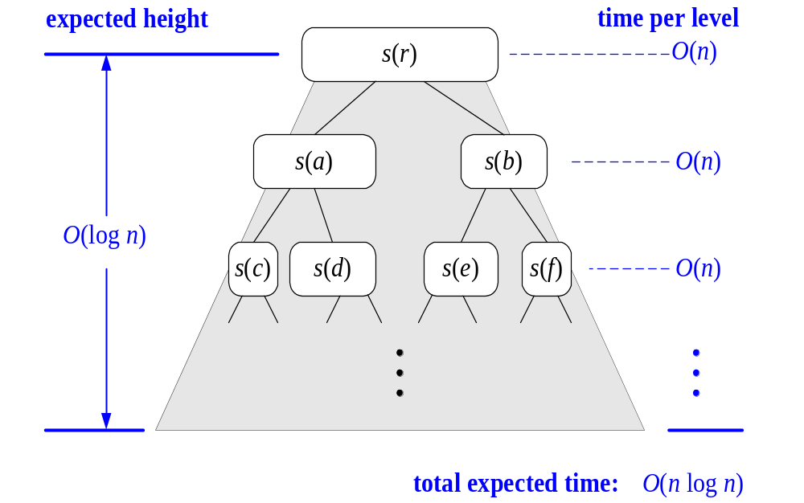
Expected Running Time, Part 2
Probabilistic Fact: The expected number of coin tosses required in order to get k heads is 2k
For a node of depth i, we expect
  i/2 ancestors are good calls
  The size of the input sequence for the current call is at most (3/4)^{i/2}n
Therefore, we have
  For a node of depth 2log_{4/3}n, the expected input size is one
  The expected height of the quick-sort tree is O(log n)
The amount or work done at the nodes of the same depth is O(n)
Thus, the expected running time of quick-sort is O(n log n)
Quick-Sort

Slide 18

In-Place Quick-Sort
Quick-sort can be implemented to run in-place
In the partition step, we use replace operations to rearrange the elements of the input sequence such that
  the elements less than the pivot have rank less than h
  the elements equal to the pivot have rank between h and k
  the elements greater than the pivot have rank greater than k
The recursive calls consider
  elements with rank less than h
  elements with rank greater than k
Algorithm inPlaceQuickSort(S, l, r)
Input sequence S, ranks l and r
Output sequence S with the
elements of rank between l and r
rearranged in increasing order
if l ≥ r
  return
  i ← a random integer between l and r
  x ← S.elemAtRank(i)
  (h, k) ← inPlacePartition(x)
  inPlaceQuickSort(S, l, h − 1)
  inPlaceQuickSort(S, k + 1, r)
Quick-Sort

Slide 19
In-Place Partitioning
Perform the partition using two indices to split S into L and E U G (a similar method can split E U G into E and G).
Repeat until j and k cross:
  Scan j to the right until finding an element > x.
  Scan k to the left until finding an element < x.
  Swap elements at indices j and k
Click here for a good illustrative example.
j
k
3 2 5 1 0 7 3 5 9 2 7 9 8 9 7 6 9
(pivot = 6)
j
k
3 2 5 1 0 7 3 5 9 2 7 9 8 9 7 6 9
Quick-Sort

Slide 20
Summary of Sorting Algorithms
Algorithm | Time | Notes
selection-sort | O(n²) | in-place slow (good for small inputs)
insertion-sort | O(n²) | in-place slow (good for small inputs)
quick-sort | O(n log n) expected | in-place, randomized fastest (good for large inputs) Quick-sort is often faster in practice than other O(n log n) algorithms.
heap-sort | O(n log n) | in-place fast (good for large inputs)
merge-sort | O(n log n) | sequential data access fast (good for huge inputs)
Quick-Sort

